Slide 1
Psychosocial Treatments for Schizophrenia
Kim T. Mueser
Center for Psychiatric Rehabilitation
Boston University

Slide 2

Disclosure
All my clothes were made by my son, J. Mueser
Bespoke Hand Tailored Suits and Shirts, with stores in New York City:
J. Mueser
19 Christopher St.
New York, NY 10014
(347) 982-4382
http://jmueser.com

Slide 3
Evidence-Based Practices (EBPs)
Services that have demonstrated their effectiveness in helping consumers to achieve important outcomes in multiple different rigorous research trials
Research trials conducted by different people and achieve similar outcomes
Programs are standardized (e.g., manuals)
Importance predicated on assumption that people with an illness have the right to the most effective scientifically validated treatments for their condition

Slide 4
Focus on 8 Established EBPs in the USA
Rationale for each EBP
Defining characteristics
Effects of practice on client outcomes
Due to time constraints, will NOT discuss coordinated specialty care (CSC) programs, an EBP for persons with first episode psychosis
  BUT, comprehensive CSC programs include many of the elements of individual EBPs reviewed here

Slide 5
Rationale for Family Psychoeducation
Many clients live with or have close contact with relatives
Living with a relative with schizophrenia or another serious mental illness (SMI) is stressful for other family members AND family stress can precipitate relapses and rehospitalizations
Families have traditionally not been engaged by treatment teams of a loved one (or even blamed), leaving them in the dark about the illness and its treatment
Families need information about the illness and its treatment to reduce burden of care and support their loved one
Most clients want their family involved in their treatment
Families (including the client) can be “extended members” of the “treatment team”

Slide 6
Goals of Family Psychoeducation
Educate family members about nature of mental illness and principles of its treatment to:
  Reduce blame and stress
  Support client’s involvement in treatment
Facilitate ability of the family to monitor the client’s illness (e.g., early warning signs of relapse) and alert treatment team of changes (“Many hands make light work”)
Promote acceptance of the illness and support for client’s recovery goals
Reduce stress in the family (on all members)

Slide 7
Family Psychoeducation Programs
Developed in 1980s
“Psychoeducation” in context of family work includes both interactive education about mental illness and teaching skills to reduce stress
Broad range of treatment models vary in terms of:
  Duration
    Short-term (1-3 months) focus on education and support
    Longer-term (6+ months) also address communication and problem solving)
  Format (individual family or multi-family)
    Easier to engage families in single family psychoeducation, especially when first episode
    Multi-family groups offer advantage of support from other families
  Primary focus
    Broad-based education
    Stress reduction and relapse prevention

Slide 8
Common Elements of Family Psychoeducation
Involve all members of the family (including client)
Are provided by mental health professionals who are members (or have access to) client’s treatment team
Approach family members in the spirit of mutual collaboration in treatment
Provide practical information and handouts about mental illness and treatment
Focus on the present and future, not the past
Demonstrate empathy for struggles family members have experienced and avoid blame and judgement
Provided by “family friendly agencies” (next slide)

Slide 9
Characteristics of “Family-Friendly” Mental Health Agencies
Routinely explore family contact with all clients and use motivational strategies to help client consider involving relatives in their treatment
Are inviting and welcoming to families
  Sufficiently large waiting rooms
  Family services available evening hours to accommodate working members
  Brochures available about classes and special topics
Have some capability of outreach to engage families in treatment by home visits
Are staffed with clinicians with special training and expertise in family psychoeducation
Have a family liaison from National Alliance on Mental illness (NAMI) or related organization to connect families with support groups and educational opportunities

Slide 10
Effects of Family Psychoeducation
Numerous studies (over 100) of family psychoeducation conducted
Short-term programs increase family knowledge of mental illness and reduce caregiver stress and burden
Longer-term family programs also reduce relapses and rehospitalizations
Family involvement improves the course of co-occurring psychiatric and substance use disorders

Slide 11
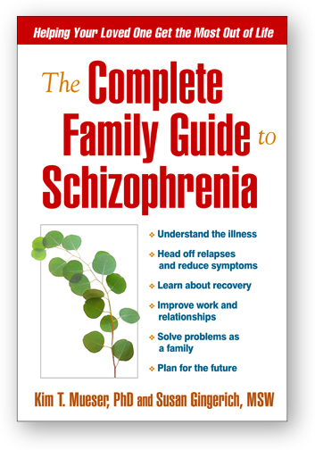

Slide 12
Rationale for Assertive Community Treatment (ACT)
Many people with schizophrenia/SMI don’t access services at local mental health centers
Psychiatric crises due to lack of treatment result in frequent relapses and rehospitalizations
Core rationale for ACT: if clients don’t come to clinic for services, bring the services to them in the community
ACT also used to facilitate transition from long-term hospitals to community and reduce homelessness

Slide 13
ACT Program Components
Developed by Stein and Test in 1970s-1980s
Reserved for clients with numerous or extended hospitalizations
Low case manager: client ratio (1:10); e.g., team of 10 ACT members for 100 clients, vs. 1:30 or higher in usual services
Most services provided by ACT team (not brokered) in clients’ natural settings (home, park)
Services often involve practical supports (e.g., paying bills, providing medication, shopping)
Shared caseloads among clinicians who serve “generalist” roles
24-hour coverage
Time unlimited services (although clients do graduate)
Similar to intensive case management

Slide 14
Effects of ACT
Note: ACT is not a rehabilitation method, but a rather a different way of organizing mental health services
Over 30 controlled studies conducted, most in the U.S.
Primary effects of ACT are reducing hospitalizations and improving stability of housing
Few other effects on psychosocial functioning unless ACT team incorporates specific other EBPs (e.g., supported employment)

Slide 16
Rationale for Supported Employment
Most people with SMI want to work: 55-70%
Competitive employment rates low: 10-25%
Benefits of work:
  better financial standing
  improved sense of self
  increased social contacts
  facilitates coping with symptoms
  personally meaningful
  Reduces risk of rehospitalization
Traditional “train-place” and sheltered vocational rehabilitation programs don’t work—“place-train” approaches like supported employment more effective

Slide 17
Individual Place and Support (IPS) Supported Employment
Developed and validated in 1990s by Becker and Drake
Eligibility for IPS based only on client’s desire to work (no rule-out criteria)
Vocational services integrated with psychiatric treatment at level of treatment team
Competitive employment is the goal
Client preferences important regarding both type of work desired and disclosure of psychiatric disability
Rapid job search begins within a month of client enrollment in program
Notes:
Each of these principles is backed by a body of research (Bond, 1998).
Detailed case examples of these principles are given in A Working Life (Becker & Drake, 1993) and in the EBP Supported Employment Workbook.

Slide 18
IPS Principles, cont’d
Each client assigned an employment specialist who provides all aspects of IPS, including:
  Active job development with and for client
  Follow-along supports
Benefits counseling to educate clients about impact of working on their disability benefits
Time unlimited services (although clients do graduate)
IPS usually organized into teams of at least 2 full-time employment specialists and a supervisor
  Frequently provided at community mental health centers (with easy access to treatment teams)
  Sometimes provided by stand-alone vocational rehabilitation agencies
Notes:
Each of these principles is backed by a body of research (Bond, 1998).
Detailed case examples of these principles are given in A Working Life (Becker & Drake, 1993) and in the EBP Supported Employment Workbook.

Slide 19
Work Rates in 25 RCTs of IPS Supported Employment

Slide 20
Overall Findings for 25 RCTs
Every study showed a significant advantage for IPS
Mean competitive employment rate:
    56% for IPS
    23% for controls

Slide 21
Rationale for Social Skills Training
Poor premorbid social functioning and following onset of schizophrenia common in many clients, and related to:
  Negative symptoms
  Cognitive difficulties
Having close and rewarding relationships are common recovery goal for clients, can reduce loneliness, and is important contributor to good quality of life (for everyone!)
Good social functioning (involved family, friends, intimate relationships, established leisure activities) improves course of illness

Slide 22
Social Skills Training (SST)
Long history:
  Developed in the 1960s as “assertiveness training”
  Applied to broader range of social skills for people with SMI in 1970s (by Liberman, Bellack, & others)
  Renamed “SST” and evaluated 1980s to present
Focuses on developing effective interpersonal skills through systematic application of learning principles and use of role plays, including:
  Modeling (demonstration) of skill
  Behavioral rehearsal (repeated practice) of skill
  Shaping (positive and corrective feedback following each role play)
  Generalization (home and in vivo practice of skill)
Skills broken down into smaller steps to facilitate gradual acquisition (shaping) of complex skills (example, next slide)

Slide 23
Steps of Expressing Negative Feelings
Look at the person; speak calmly and clearly
Say exactly what they did that upset you
Tell them how it made you feel
Suggest how person might prevent this from happening in the future

Slide 24
SST, cont’d
Usually taught in groups of 6-8 clients based on pre-planned curricula of skills
Can be provided in any treatment setting (e.g., acute inpatient, long-stay hospital, local mental health centers, residential programs, ACT teams)
Groups last from 2 weeks to a year (or more), depending on setting and specific goals
Specific skills taught based on goals of participants and organized into SST “menu"
Skills drawn from curricula covering broad range of social situations (e.g., conversations, assertiveness, friendship & dating, conflict resolution, work/school, substance use, healthcare, technology-based)
Groups are lively, positive, and fun with premium place on practicing (rather than talking about) skills
New resource available (next slide)

Slide 25
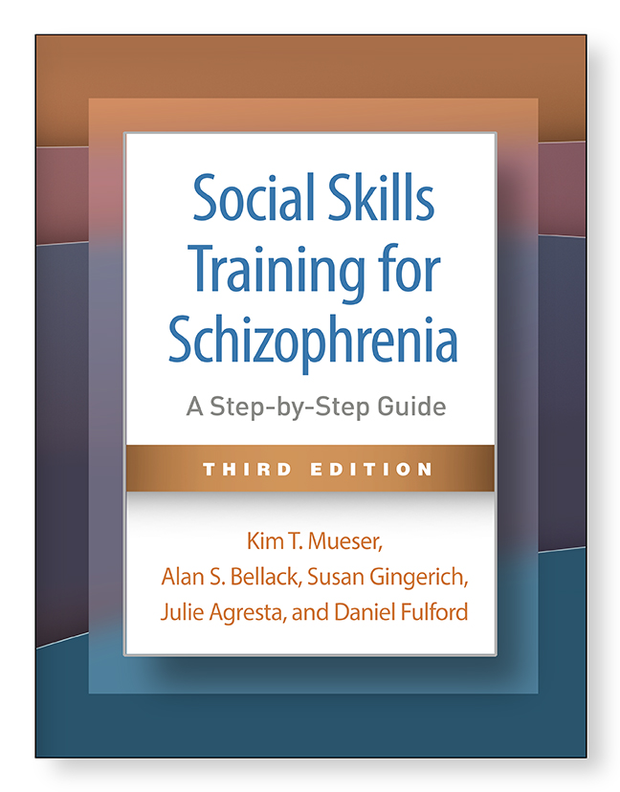
Recently published:
Social Skills Training for Schizophrenia: A Step-By-Step Guide, 3rd Edition. New York: Guilford Press, 2024.
Includes curricula for 84 skills across 12 different topic areas

Slide 26
Effects of SST
Numerous studies of SST, dating back 40+ years
Research shows SST is more effective than other interventions at:
  Improving social functioning
  Reducing negative symptoms
In addition, SST:
  Improves self-efficacy
  Has modest effect on reducing relapses and rehospitalizations

Slide 27
Rationale for Cognitive-Behavior Therapy for Psychosis
Persistent psychotic symptoms (e.g., hallucinations, delusions) present in 25-40% of persons with schizophrenia
Psychotic symptoms increase chances of relapses and rehospitalizations
High distress associated with persistent psychotic symptoms

Slide 28
CBT for Psychosis (CBTp)
Based on principles of CBT (as applied to depression):
  Thoughts and beliefs influence how people feel and react in different situations
  Not all thoughts and beliefs are accurate
  Examining one’s thinking when feeling upset, and changing inaccurate thoughts to more accurate ones, can improve feelings and behavior
  Adapted for people with psychotic symptoms
12-25 individual sessions most common
Collaborative partnership formed with client
Education about stress-vulnerability model
Coping strategies taught for distressing symptoms
Exploration with client about alternative interpretations for psychotic symptoms
Non-confrontational
Behavioral tests to check out accuracy of beliefs

Slide 29
Effects of CBTp
Numerous controlled studies conducted 1990s-2020
Most studies focus on clients with persistent psychotic symptoms
CBTp improves
  Psychotic symptoms
  Negative symptoms
  Functioning
Is effective for people with medication-resistant psychotic symptoms

Slide 30
Rationale for Illness Self-Management
Medication non-adherence common problem
Relapses and hospitalizations frequent, disruptive, and costly
Even with optimal pharmacological treatment, persistent symptoms common
Historically, clients were viewed as passive recipients rather than active partners in treatment
Need to fully engage clients in their own treatment to develop capacity for illness self-management

Slide 31
Illness Self-Management Programs
Multiple programs developed to teach illness self-management
Common components of programs include:
  Psychoeducation about mental illness and treatment
  Medication adherence strategies
  Building social support
  Skills for coping with stress and symptoms
  Relapse prevention
Most comprehensive program is Illness Management and Recovery (Gingerich & Mueser, 2003, 2010, 2011)

Slide 32
Illness Management and Recovery (IMR) Program
Developed based on comprehensive review of research on illness self-management training
Incorporates specific illness self-management strategies supported by research in over 40 studies (psychoeducation, coping strategies, etc.)
Can be taught in groups or individually
5-10 months of weekly or twice weekly sessions
11 educational handouts covering topics such as Recovery Strategies, Practical Facts About Mental Illness, Building Social Support, and Preventing Relapses
Practitioners use motivational, educational, and cognitive behavioral teaching techniques
Clients set and pursue personal recovery goals
Clients practice skills in IMR sessions
Home assignments to practice skills and pursue goals collaboratively set
Significant others involved

Slide 33
Personal Definition of Recovery
“Recovery involves the development of new meaning and purpose in one’s life as one grows beyond the catastrophic effects of mental illness.” (Anthony, 1993)
Notes:
NOTE; THE INTRODUCTORY VIDEOTAPE WAS SHOWN JUST PRIOR TO THIS SLIDE.
As you could see in the introductory video, the concept of recovery is critical to this intervention. There are many definitions of recovery, including the one on this slide.

Slide 34
Effects of IMR Program
IMR translated into 20+ languages
Multiple variants of IMR developed to address comorbid disorders (e.g., physical health, substance use), common goals (e.g., work, stable housing), and special populations (e.g., intellectual disability)
Numerous studies conducted
IMR shown to:
  Improve illness self-management
  Reduce symptoms severity
  Prevent relapses

Slide 35
Rationale for Cognitive Remediation
Cognitive impairment common in persons with schizophrenia and other SMIs
Related to worse psychosocial functioning, including:
  Self-care and independent living
  Social relationships
  Work
Associated with reduced benefit from psychosocial rehabilitation (e.g., SST, supported employment)

Slide 36
What is Cognitive Remediation (Cog Rem)?
“Cognitive remediation is an intervention targeting cognitive deficit using scientific principles of learning with the ultimate goal of improving functional outcome. Its effectiveness is enhanced when provided in a context (formal or informal) that provides support and opportunity for extending everyday functioning.”.”
(Cognitive Remediation Therapy Expert Working Group; SIRS meeting, 2012)

Slide 37
Cog Rem Programs
Early programs based on treatment of head injury patients
Programs vary in intensity and length from several weeks to over 1 year
Some programs integrated with other psychosocial treatments (e.g., SST, supported employment) but not others
Cognitive specialist/clinician/facilitator needed to link Cog Rem to client goals
Cognitive remediation methods include:
  Computer-based cognitive exercise practice
  Coaching in new cognitive strategies during practice of exercises to improve performance
  Teaching cognitive self-management strategies to improve everyday cognition(

Slide 38
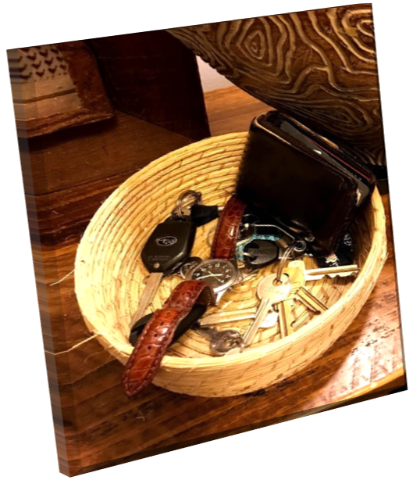

Cognitive Self-Management Strategies
Strategies to help people improve their cognitive performance in everyday situations, such as work, school, or home
Example
A Memory Spot is a designated place to store frequently used items such as your KEYS, WATCH, OR WALLET so you don’t have to remember where you put them
SR McGurk & KT Mueser, Cognitive Remediation for Successful Employment and Psychiatric Recovery: The Thinking Skills for Work Program. New York: Guilford Press, 2021.

Slide 39
Effects of Cog Rem Programs
Numerous studies conducted over past 40 years
Cog Rem programs improve:
  Cognitive functioning (moderately)
  Psychosocial functioning (moderately)
  Symptoms (modestly)
However, programs that are integrated with other psychosocial treatments have a much stronger impact on functioning than stand-alone Cog Rem programs
Cog Rem improves ability of clients to benefit from other EBPs (example on next slides)

Slide 40
Example of Integrate Cog Rem Program: Thinking Skills for Work (TSW)
Comprehensive cognitive enhancement program (McGurk & Mueser)
Integrates cognitive enhancement with supported employment for clients who want to work
Provided by a cognitive specialist, who is member of the supported employment team
Includes computer cognitive training, strategy coaching, and teaching cognitive self-management strategies (self-management strategies only version available)
Requires 6-12 months to complete
Effective at improving cognitive and competitive work outcomes in 7 controlled studies
Example (next slide) of effects from study of IPS supported employment “non-responders” (N = 107) offered additional TSW program vs continued IPS services only (McGurk et al., 2015)

Slide 41
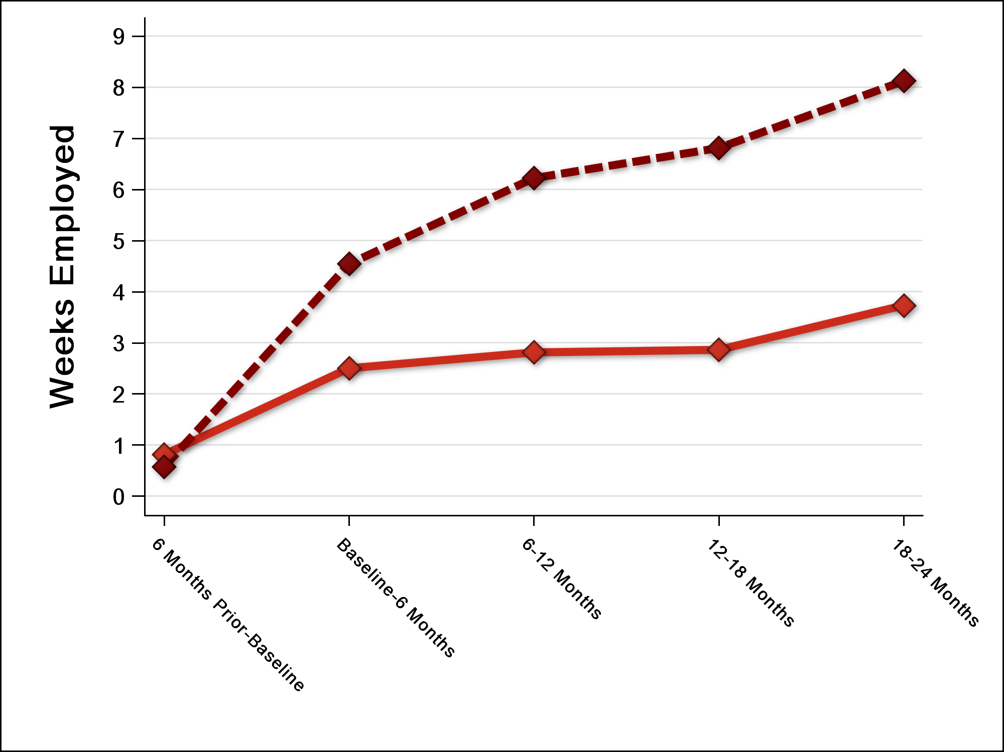

Weeks of Competitive Employment
(per 6 month period)

Slide 42
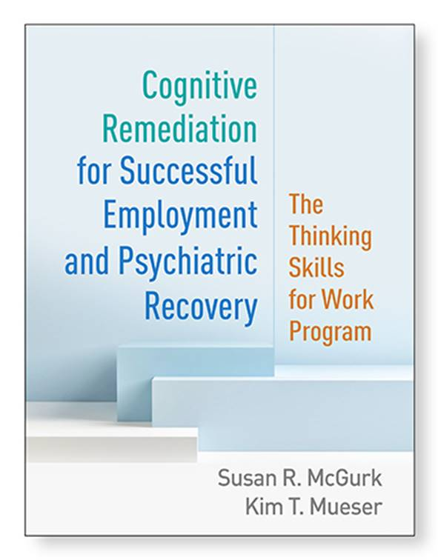

Slide 43
Rationale for Integrated Treatment for Co-Occurring Disorders
Substance use disorders common in SMI (next slide)
Substance use worsens course of illness, leads to premature mortality
Traditional approaches to treating mental illness and substance use separately are ineffective
Integrated treatment is solution to problem

Slide 45
Integrated Treatment for Co-Occurring Disorders
Treatment for mental health and substance use disorders:
  Delivered concurrently
  By the same team or group of clinicians
  Within the same program
  Burden of integration is on the treatment team

Slide 46
Other Features of Integrated Treatment Programs
Motivational enhancement, based on stages of change/treatment (precontemplation, contemplation, etc.)
Group, individual, and family approaches
Comprehensive services
Minimization of treatment-related stress
Harm reduction philosophy

Slide 47
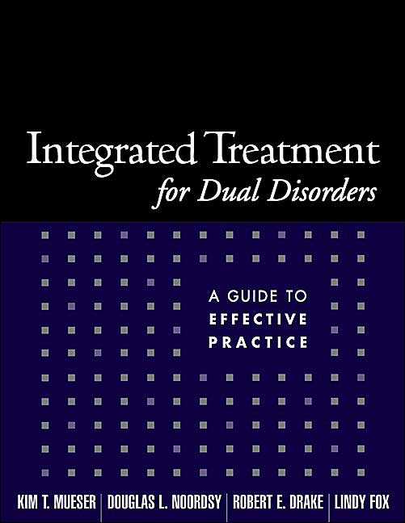
The Principles of Integrated Treatment

Slide 48
Effects of Integrated Treatment Programs
Integrated treatment improves substance use problems and related outcomes
Strongest effects for group-based interventions
Subgroup of clients have persistent co-occurring substance use disorder despite integrated treatment
  Need to focus broadly on improving psychosocial functioning and not only on substance use outcomes

Slide 49
Other Psychosocial EBPs
Effective psychosocial EBPs (not reviewed here) have also been developed for persons with SMI to address other problem areas, including:
  Self-management of co-occurring physical health conditions (e.g., diabetes)
  Health promotion (exercise, diet, weight, smoking cessation)
  Co-occurring trauma/posttraumatic stress disorder (PTSD)

Slide 50
Conclusions
A growing number of EBPs exist for improving psychosocial functioning in people with schizophrenia and other SMIs
The major challenge to the field is to increase the access of people with SMI to EBPs, many of which have decades of research supporting them
Such effort requires involvement of stakeholders at all levels: clients, family members, clinicians, administrators, policy makers, and the community

