Slide 1
Schizophrenia 101
Brian Kirkpatrick, MD, MSPH
John Emmett Peters, MD, Chair of Psychiatry
Psychiatric Research Institute
University of Arkansas for Medical Sciences

Slide 2
Disclosure
Royalties from MedAvante/ProPhase LLC for use of the Brief Negative Symptom Scale (BNSS); these fees are donated to the Brain and Behavior Research Foundation.
Honoraria and travel support from MedAvante/ProPhase for consulting & for training raters on the BNSS
Consulting fees and travel support from Minerva Neurosciences, Acadia Pharmaceuticals, and ProPhase LLC.
CEO and part owner of Quantic Innovations, which provides consulting services to the pharmaceutical industry.

Slide 3
Vocabulary
Hallucination:
  Thinking you heard, saw, felt, smelled, or tasted something without an external cause
  Not just voices!
Delusion:
  A fixed, false belief that other people in a person’s subculture don’t share
Disorganized speech:
  Irrelevant or incoherent statements
  Usually, when we say “psychosis” or psychotic symptoms” or “positive symptoms” we mean these three.

Slide 4
Catatonia
A person gradually
  Speaks less
  Moves less
  Reacts less
At an extreme, will not speak, not move, but have
  A rapid heart rate
  Fever

Slide 5
Negative Symptoms
A decrease or absence in normal thought or behavior
Expressivity
Blunted affect: a decrease in the unspoken parts of communication that are used to emphasize or clarify what is being said
  Facial expression
  Vocal expression
  Body language/expressive gestures
Alogia (poverty of speech): few words spoken, little information conveyed
Motivation and Pleasure
Avolition: reduced starting and persisting in goal-directed activity, and a decrease in the desire to do so
Anhedonia: a decrease in the frequency and intensity of pleasure, including anticipated pleasure
Asociality: reduced social activity and decreased interest in close relationships

Slide 6
Schizophrenia: Criteria
Two or more of the following for 1 month (less if treated); at least one must be 1, 2, or 3:
  Delusions
  Hallucinations
  Disorganized speech
  Grossly disorganized or catatonic behavior.
  Negative symptoms
  Decline in function
  Continuous signs for at least 6 months
Exclusions: drugs, bipolar disorder, neurological cause, etc.

Slide 7
Some People I Know
  Suzy
  Bob
  Thad

Slide 8
People vary

Slide 9
I’ve heard that!

Slide 10
It’s a genetic disorder

Slide 11
Kind Of
Dozens of genes increase the risk of schizophrenia
None of them account for as much as 3% of cases
In identical twins—whose genes are all the same—if one twin has schizophrenia, the other twin has it just a third of the time.
It’s possible that a single gene never leads to schizophrenia without some other factor (including another risk gene)

Slide 12


Slide 13
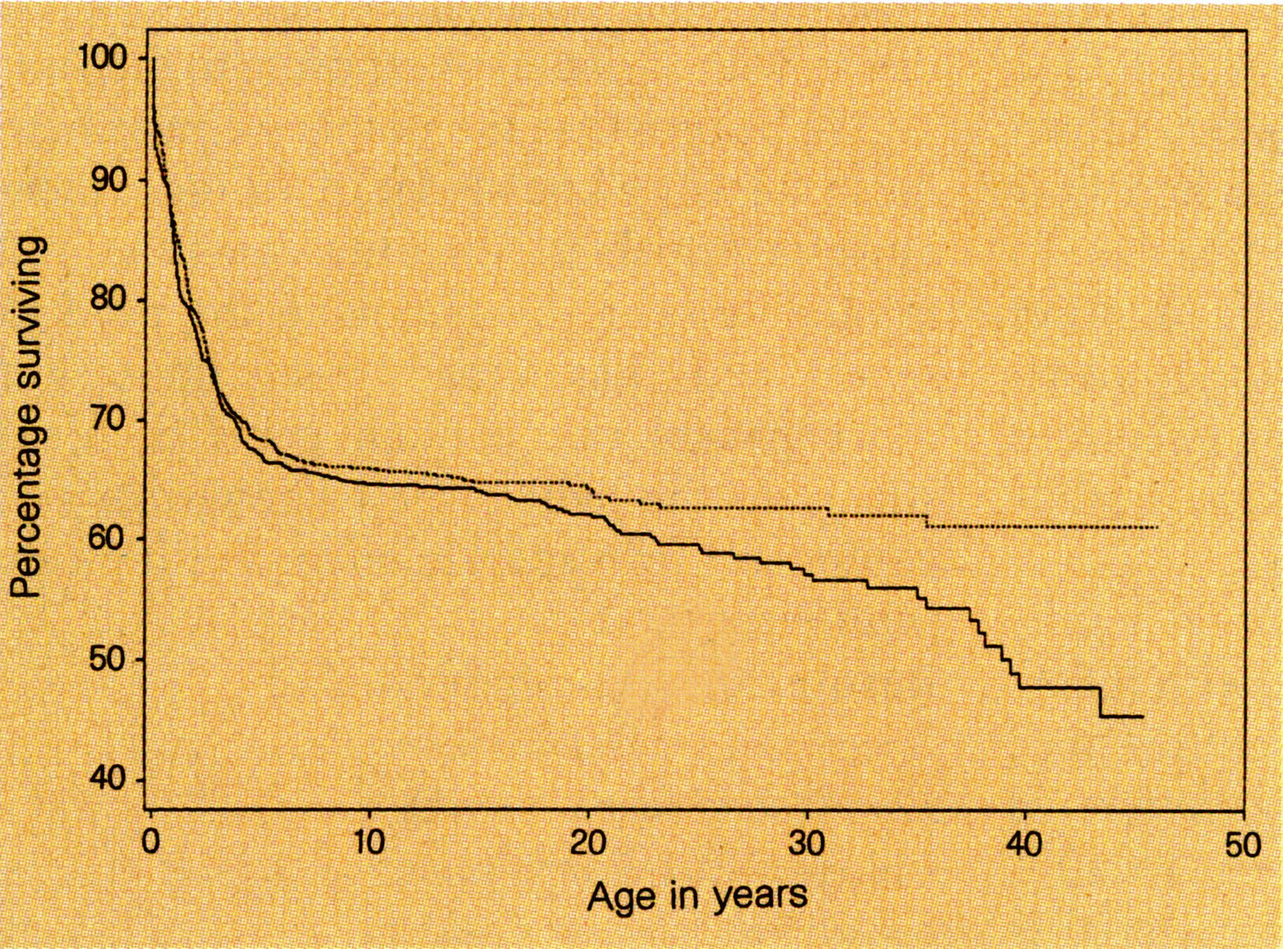

Slide 14
Prenatal Determinants of Adult Disease
Problems during pregnancy and delivery increase the risk of several adult diseases
  Hypertension
  Cardiovascular disease
  Diabetes
  Some cancers

Slide 15
There are no known environmental risk factors for schizophrenia

Slide 16
Prenatal
  Rainfall in a tropical region (Brazil, Singapore)
  Prenatal famine
  Any significant stress on the mother, if it occurs at the right time during pregnancy
    Respiratory illnesses
    Husband’s death
    Tornadoes that cause fatalities in the neighborhood
  Low birth weight
  Advanced paternal age

Slide 17
Perinatal
  Season of birth
    Winter birth for schizophrenia as a whole
    Summer birth in a particular group of people with schizophrenia
  Obstetrical complications
    low birth weight
    problems with the placenta
    gestational diabetes

Slide 18

Childhood/Adolescence & Other
Childhood
  Significant abuse, especially sexual abuse
Adolescence
  Heavy marijuana use
Other
  Living in an urban vs rural area
    Higher risk factor if you’re raised in an urban area
  Migration to another society

Slide 19
What do the Risk Factors Mean?
Differences in early brain development underlie many (most? all?) cases of schizophrenia
There are
  so many genes of risk
  so many environmental risk factors—with different timing during brain development
  And simply because they’re human, and are so different, we shouldn’t expect people with schizophrenia to have
  The same pattern of symptoms or severity
  The same biological changes

Slide 20
If there is a physical or biological basis for schizophrenia in the brain, we don’t know much about it.

Slide 21
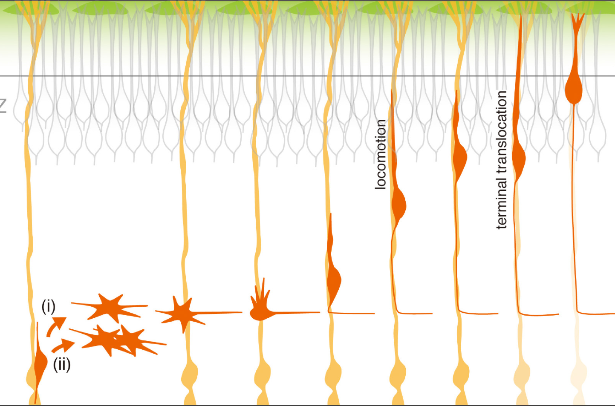

Slide 22
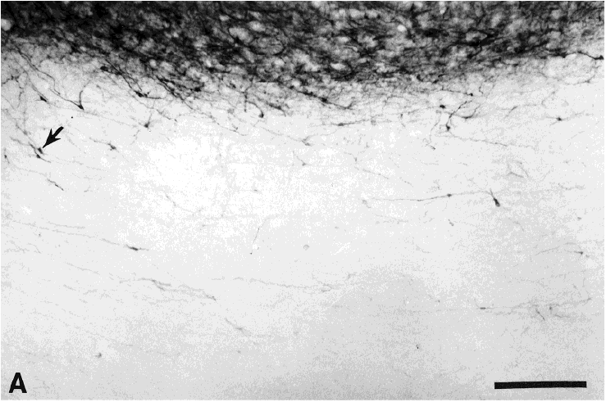

Slide 23
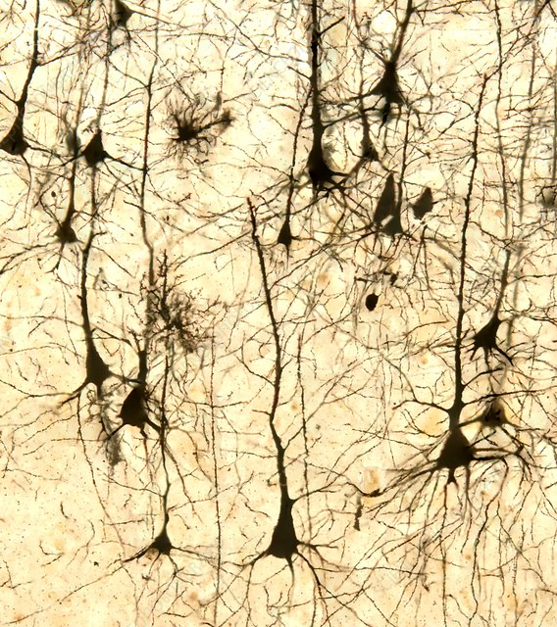
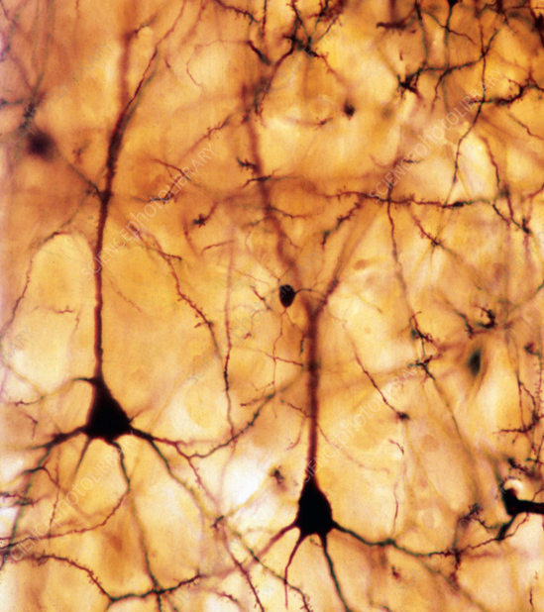

Slide 24
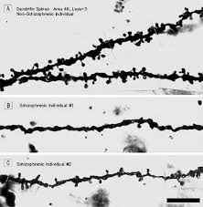
Fewer, smaller, spines.

Slide 25
Schizophrenia is a brain disorder

Slide 26
Yes and No
Minor physical anomalies: from head to toe
  Flatter palate
  Space between toes
  Subtle differences in the ear
  Others
Prediabetes
Inflammation
Decreased androgens in men
Slightly elevated prolactin in men and women

Slide 27
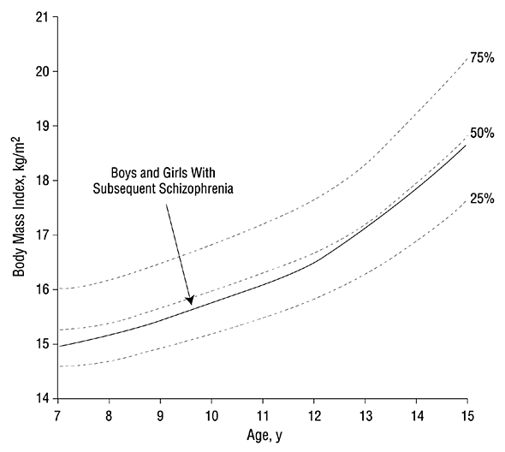
  Abnormal white matter tracts
  Fewer long distance fibers

Slide 28
Schizophrenia is all about dopamine
(We know that because of the antipsychotic drugs)

Slide 29
What’s Wrong with the Dopamine Theory
Suzy’s experience:
  Antipsychotics make hallucinations, delusions, disorganization & catatonia go away in some people
  Other people’s symptoms don’t improve at all (they may become calmer & less upset)
  And there is every degree of improvement in between

Slide 30
The function of people with schizophrenia deteriorates over time

Slide 31
Average Course
Premorbid (before the onset of psychosis)
  Mild childhood social, cognitive, mood, motor, level of function problems
Longterm:
  Function at its worst within five years of first clinical contact for psychotic symptoms
  May plateau for a time
  Then a gradual improvement in positive symptoms & function

Slide 32
If you don’t have schizophrenia by the age of thirty, you can’t get it

Slide 33
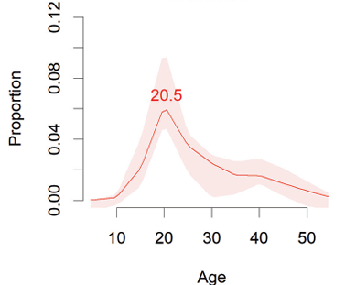

Slide 34
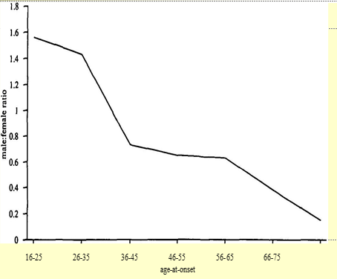

Slide 35
If you can treat the psychotic symptoms, everything will be fine

Slide 36
Other Neurological & Psychiatric Problems
Negative symptoms
Demoralization
Serious depression
Some cognitive problems
Anxiety disorders (including PTSD & obsessive-compulsive symptoms)
Neurological signs *
Abnormal, involuntary movements not caused by the drugs *
A subtle problem in control of eye movements *
Polydipsia

Slide 37
When someone deals with schizophrenia it’s painful for that person’s loved ones because there’s nothing they can do to help

Slide 38
Cost/benefit
Even a very few hours of family “psychoeducation” can
have a substantial impact on number of relapses & hospitalizations.

Slide 39
The only thing people with schizophrenia can do to help themselves is take their medicine.

Slide 40
Learning strategies
Psychosocial treatments, but also:
  Quiet or loud?
  Asking for confirmation
  Drug abuse
  “Distancing” themselves from hallucinations and delusions

Slide 41
What is Schizophrenia?
It isn’t a brain disorder; it’s a disorder of the entire body in which psychosis is present
In many patients, there are phases of illness in which psychosis is not the psychiatric problem with the greatest impact on their function (e.g. depression, negative symptoms, concentration problems, etc.)
To say schizophrenia is due to a dopamine abnormality because one aspect of the illness—psychosis—responds (to a varying degree) to dopamine drugs is like saying bubonic plague is a disease of aspirin insufficiency because your fever goes down some.
It may be most accurate and useful to think of it as a group of rare diseases

Slide 42
What Can Be Done?
The treatments help, if the person with the illness (and family) become engaged
  And help shape treatment
People with schizophrenia can often develop strategies to manage their problems
Ideally, the person with schizophrenia, that person’s loved ones, and clinicians work together to figure out the strategies that work best
Most people with schizophrenia can have lives with meaning.
There’s hope

Slide 43
Odyssey Clinic
Patients with psychosis
  “First episode”
      Symptoms present two years or less
  Symptoms aren’t due to other causes
      Depression or mania with psychotic features
  A neurological problem (delirium, drugs, etc.)
Services offered:
  Psychotherapy
  Medication management
  Case management
  Employment and educational support
  Family contact
  Connection with primary care
      Symptoms present two years or less

Slide 45
