Slide 1
Medications:
Past, Present and Future
Deanna L. Kelly, Pharm.D., BCPP
Dr. William and Carol Carpenter Professor of Psychiatry for Mental Illness Research
MPower Professor: University of Maryland Strategic Partnership: MPowering the State
Acting Director, Maryland Psychiatric Research Center (MPRC)
University of Maryland School of Medicine

Slide 2
Disclosures
Served as an advisory board member for Alkermes, Karuna and Teva in the past 2 years
Serves as a content expert for MedScape
Funded by NIMH and NSF

Slide 3
Learning Objectives
Identify different classes of medications used in the treatment of schizophrenia spectrum / psychotic disorders
Describe the relative benefits and risks of different pharmacologic treatment approaches
Understand the factors taken into consideration when choosing a particular treatment strategy

Slide 4

Notes:
Morpheus before Neo takes the red pill. What if I told you every thing you know to be true is wrong….

Slide 5
What are the goals of treatment?
ALLEVIATE SYMPTOMS
IMPROVE FUNCTIONING
BETTER QUALITY OF LIFE
Rx
Rx + psychosocial
POSITIVE
NEGATIVE/COGNITIVE
Also reduce medical comorbidities, increase lifespan, prevent suicide

Slide 6

Pharmacologic Treatments
Antipsychotic medications
  First Generation Antipsychotics (Typical)
  Second Generation Antipsychotics (Atypical)
    Treat positive symptoms
  Third Generation Antipsychotics (?)
    Treat negative and cognitive symptoms too?
Prevent and manage side effects

Slide 7
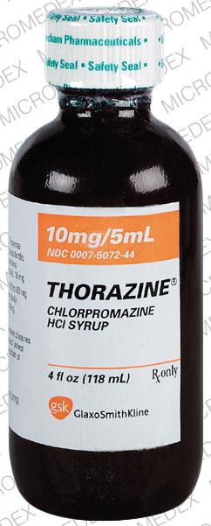

Typical Antipsychotics
Act primarily through blocking a neurotransmitter believed to be elevated in schizophrenia called dopamine (D2)
Good at reducing positive symptoms
Greater risk of side effects that cause abnormal movements
  Extrapyramidal symptoms (EPS)
  Tardive dyskinesia (TD)
Can also cause emotional blunting, low blood pressure, sedation, weight gain
https://www.mdpi.com/1422-0067/21/24/9532

Slide 8
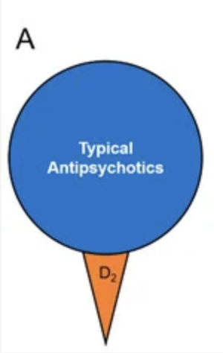
Typicals or First Generation Antipsychotics
  haloperidol (Haldol)
  fluphenazine (Prolixin)
  thiothixene (Navane)
  trifluoperazine (Stelazine)
  perphenazine (Trilafon)
  loxapine (Loxitane)
  chlorpromazine (Thorazine)
  thioridazine (Mellaril)
  pimozide (Orap)

Slide 9
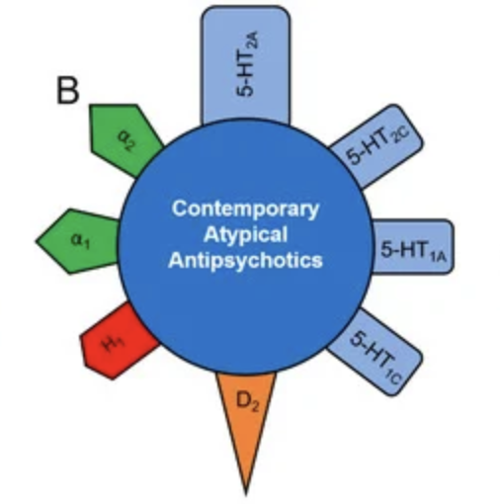

Atypical Antipsychotics
Action primarily through blocking dopamine (D2) but also another neurotransmitter serotonin (5HT2) and other receptors
Lower risk of abnormal movements

Slide 10
Atypicals or Second Generation Antipsychotics
  olanzapine (Zyprexa)
  risperidone (Risperdal)
  paliperidone (Invega)
  aripiprazole (Abilify)
  quetiapine (Seroquel)
  ziprasidone (Geodon)
  lurasidone (Latuda)
  asenapine (Saphris)
  iloperidone (Fanapt)
  brexpiprazole (Rexulti)
  cariprazine (Vraylar)
  lumateperone (Caplyta)
  clozapine (Clozaril)

Slide 11
Moving Away from Dopamine Blockade- Looking for New Treatments
Presynaptic Dopamine partial agonist / postsynaptic dopamine antagonist, 5-HT2A antagonist, 5-HT transport inhibitor, presynaptic, D1-regulated NMDA and AMPA agonist
Lumateperone
Partial Dopamine Agonism
Aripiprazole
Brexpiprazole
Cariprazine (D3 agonism too)

Slide 12
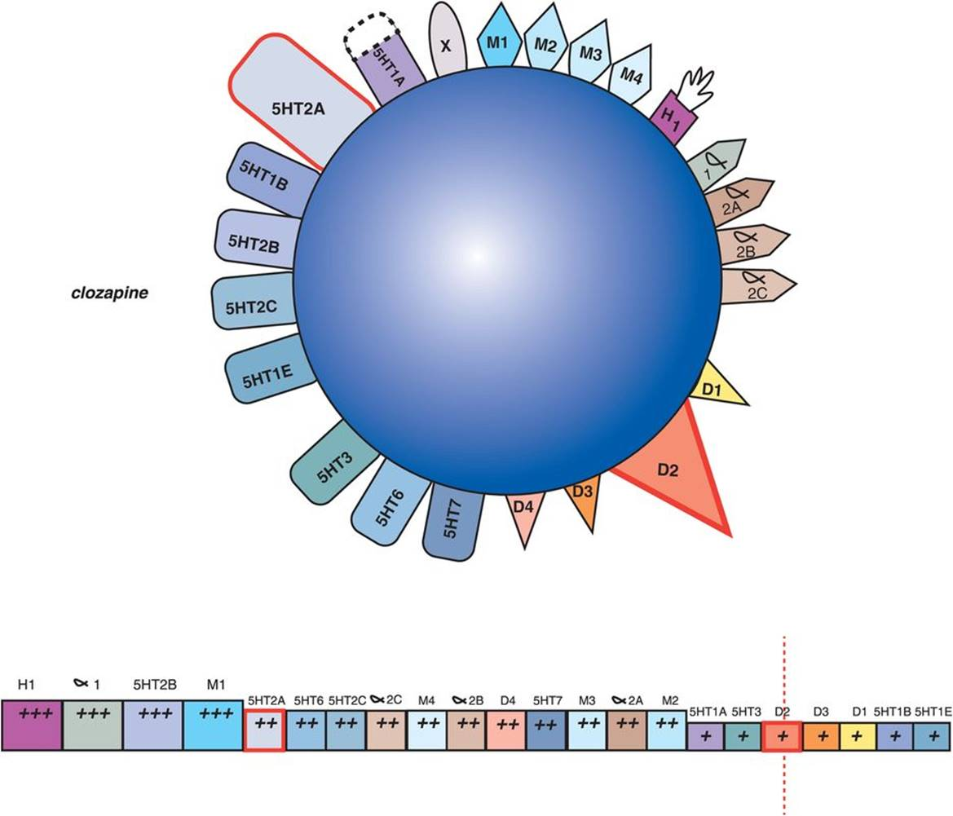
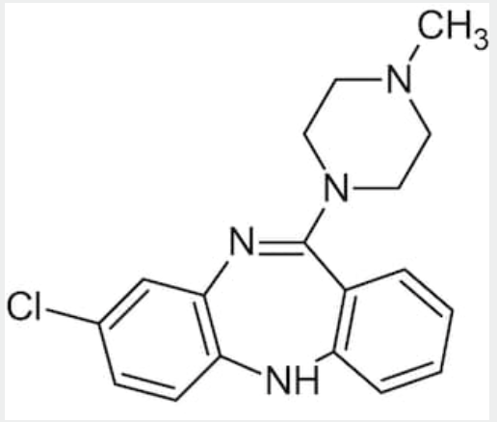
Clozapine
Also FDA approval for reduced suicidality
Improvements in aggression/violence/TD
Requires blood draws for monitoring (currently)
Overall, very underused
https://www.abcam.com/clozapine-atypical-antipsychotic-ab120019.html

Slide 13
Exciting Times- New Antipsychotics
Acetylcholine (ACh) s a neurotransmitter that plays a role in memory, learning, attention, arousal and involuntary muscle movement
Can bind to two types of receptors: nicotinic receptors and muscarinic receptors
Cholinergic hypothesis of schizophrenia suggests that a decrease in ACh activity can lead to schizophrenia.
New antipsychotic approved in September stimulating muscarinic (M1 and M4) receptors in the brain

Slide 14
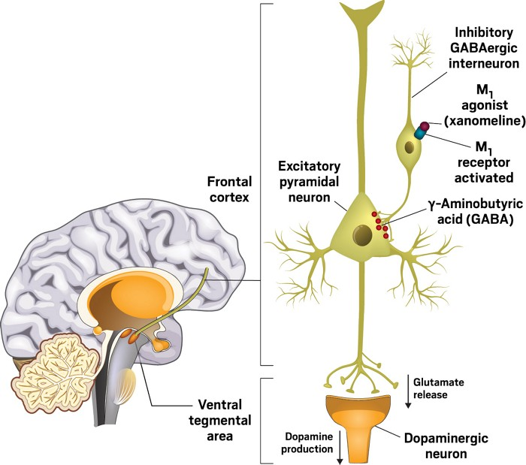
Xanomeline + Trospium Chloride:
Xanomeline is primarily a M1/M4 muscarinic agonist (with some M5 agonist activity)
Can decrease dopamine indirectly
To minimize peripheral effects of xanomeline, trospium chloride added to block peripheral muscarinic agonism (not crossing the blood brain barrier)
Brannan SK. N Engl J Med. 2021 Feb 25;384(8):717-726.
Brannan SK. N Engl J Med. 2021 Feb 25;384(8):717-726.

Slide 15
Other Antipsychotics in the Pipeline
TerXT (prodrug, possibly long acting)
NBI-1117568 also M4 agonist
ALTO-101 phosphodiesterase4 inhibitor
Recent disappointments but further looking:
  Emradicline- M4 agonist, less peripheral GI side effects. Nov results disapointing
  Iclepertin-glycine transporter inhibitor; increases glycine levels and its ability to modulate NMDA receptor function- Jan results disappointing
  TAAR1 agonists (Trace amine-associated receptors)
Several medications for cognitive impairments:
    GABAb receptor agonist, NMDA receptor agonist, nicotinic receptors agonist
    CNS-penetrant soluble guanylate cyclase (sGC) stimulator, a key enzyme of the nitric oxide (NO) signaling pathway
    Dopamine 1 partial agonist

Slide 16

Factors to consider in treatment choice
Efficacy
Tolerability
Formulation
PATIENT PREFERENCE

Slide 17
Factors to consider in treatment choice
Factors to consider in treatment choice:
  Efficacy (How well does it work?)
  Tolerability
  Formulation
  PATIENT PREFERENCE

Slide 18
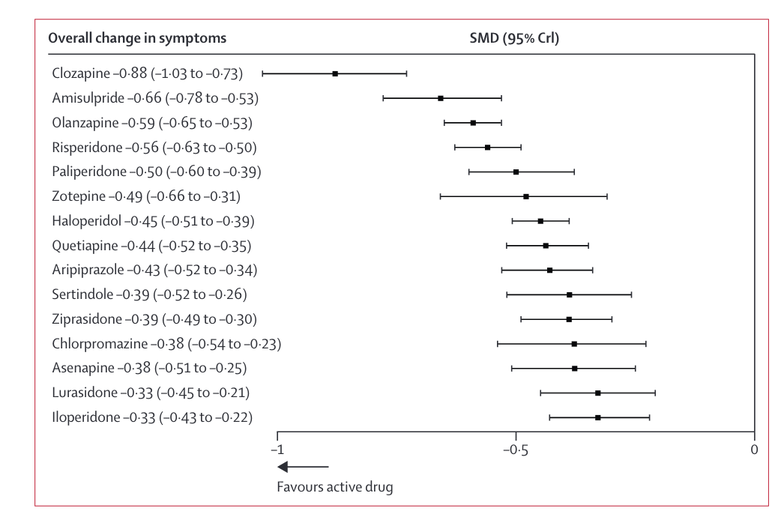
Efficacy
Current typicals and atypicals show similar efficacy for positive symptoms
Looking for better efficacy instead of incremental improvements
Clozapine approved for treatment resistant schizophrenia only (two failed trials)
(Leucht et al., 2013)

Slide 19
Clozapine Efficacy and Effectiveness
Most effective antipsychotic for treatment resistant schizophrenia / persistent positive symptoms
  40% have response to clozapine (95% CI 36.8 to 43.4%)
Several large effectiveness studies suggest that clozapine :
  has significantly greater time to treatment discontinuation
  has significantly greater patient perceived ratings
  is associated with significantly greater clinician improvement ratings
  More cost effective
Siskind et al Can J Psychiatry 2017, Lieberman JA, et al.. N Engl J Med. 2005;353:1209–23; Lewis SW, et al. Schizophr Bull. 2006;32(4):715–23; Velligan, et al. Psychiatric Services 2015;66(2):127-33; Goren et al Psychiatric Services 2016

Slide 20
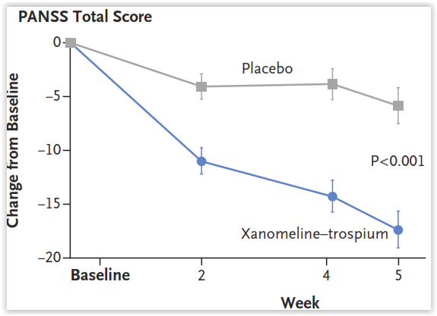
Xanomeline + Trospium Chloride Phase 2B study:
Primary Efficacy Endpoint: PANSS Total at Week 5
EMERGENT 1
ES=0.75
Brannan SK. N Engl J Med. 2021 Feb 25;384(8):717-726.

Slide 21
Xanomeline + Trospium Chloride Phase 3 studies:
EMERGENT 2 and 3
In 2 completed phase 3 trials, KarXT was associated with clinically meaningful and statistically significant improvement in symptoms of schizophrenia as measured by change in PANSS total score
KarXT had an improvement of 8-10 point more than placebo with a 20 point drop seen again.
Improvements were noted at week 2 and sustained through all time points in the trial
Correll CU, et al. Presented at: NPA; Feb 15-18, 2023; Las Vegas, NV. Poster presentation

Slide 22
Factors to consider in treatment choice
Factors to consider in treatment choice:
  Efficacy
  Tolerability (Are there side effects?)
  Formulation
  PATIENT PREFERENCE

Slide 23
Antipsychotic Side Effects: Patient Burden
Reported Side Effect | Frequency %
Daytime Drowsiness | 75.0
Dry Mouth | 58.2
Weight Gain | 50.0
Polydypsia/Polyuria | 48.1
Akathisia | 45.7
Sedation | 44.7
Dizziness/Hypotension | 40.9
Bradykinesia | 39.9
Tremor | 34.6
Tachycardia | 29.3
Hypersalivation | 29.3
Blurred Vision | 27.4
Dystonia | 26.9
Nausea/Vomiting | 26.0
Negative experiences can shape their opinions about antipsychotic medications long-term
Up to 80% of patients will stop antipsychotics prematurely
Antipsychotic side effects negatively impact adherence but are largely underreported
  Only about 28% of people experiencing side effects tell their clinician
Hynes C, et al. Ther Adv Psychopharmacol 2020; 10:1; Lacro JP, et al. J Clin Psychiatry 2002; 63: 892–909.Lambert M, et al. Eur Psychiatry 2004; 19:415–422.;
Notes:
71.5% had not reported side effects to a clinician prior to systematic assessment
46% taking olanzapine
21% quetiapine
10-11% each Cloz, Pali, Risp
Only 14% prescribed 1 antipsychotic alone
Lorazepam 27%
Zopiclone 24%
VPA 15%

Slide 24
Antipsychotic Side Effects: Person Perspective
Frequency of Side Effect | 74.7% | 51.1% | 48.7% | 54.5% | 83.5% | 54.0% | 52.4% | 53.4%
VAS Visual Analog Scale. Subset analysis based on whether key side effect is reported on the GASS scale. Higher functional severity indicates worse impact
Tandon R, et al. Ann Gen Psychiatry 2020;19:42
Notes:
Similar rates as reported in the previous study
Multinational survey of 435 adult participants diagnosed with schizophrenia
Stable for at least 1 month
Currently taking SGA for 1-12 months
Reporting at least 1 side effect according to GASS

Slide 25

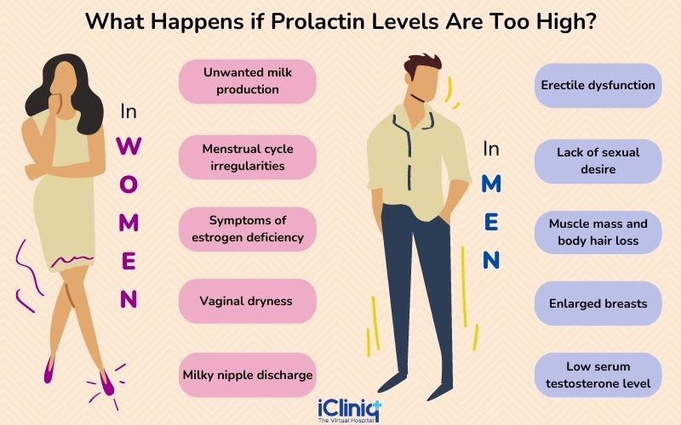
Side Effects from Blocking Dopamine
Raise prolactin
Increase movement disorders
  Dystonia
  Rigidity
  Tremor
  Dyskinesia
  Akathisia
Inoue A, Nakata Y. Jpn J Pharmacol 2001;86:376-380, Seesack SR, Carr DB. Pysiol Behavior 2002;77:513-7, Kegeles LS, et al. Arch Gen Psychiatry 2010;67:231-9.

Slide 26
Prevalence of Tremor and Parkinsonism
None seen
Martino D, et al. The Canadian Journal of Psychiatry 2018; 63(11):730
*Correll CU, et al. 2020; 77(4): 349–358
+Frankel JS, et al. 2017; 7(1):29
Notes:
Lumateperone tremor and Parkinson = n/a
Cariprazine – tremor was considred a component of PD in the studies utilized in this review

Slide 27
Prolactin Elevation
Huhn M, et al. Lancet 2019; 394:939*Correll CU, et al. 2020; 77(4): 349–358

Slide 28



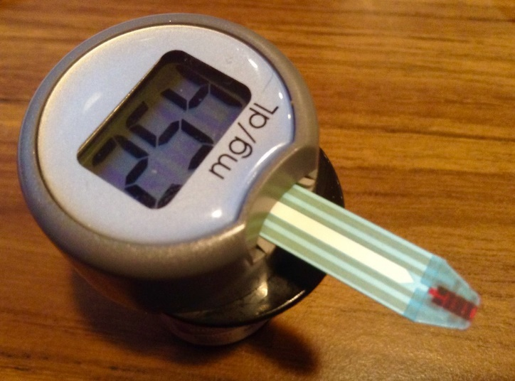

Other Antipsychotic-Related Side Effects
https://commons.wikimedia.org/wiki/File:Noun_confusion_2452309.svg, https://www.flickr.com/photos/jeepersmedia/15583760513, https://pixabay.com/, https://thenounproject.com/
Notes:
Images obtained from advanced google search fingering for creative commons licensing or from referenced websites
Terms: Akathisia, restlessness, muscle stiffness, torticollis, Parkinson disease, chest discomfort

Slide 29
Weight Gain: Mean Difference From Placebo
Huhn M, et al. Lancet 2019; 394:939
*Correll CU, et al. 2020; 77(4): 349–358
Notes:
Lumateperone Wt
Median = 0.9 kg (-36 to 11 kg)
Mean ~ 1.25 kg (0.8 to 1.8 kg) MD = ~0.3

Slide 30
Clozapine
Common: salivation, fast heart rate, tiredness
Serious:
    Constipation (30-50%)
    severe neutropenia (0.05-0.86%)
      Clozapine REMS registration and monitoring
    seizures (1-3% risk)
    myocarditis (3% risk)
    cardiomyopathy (0.02-0.1% risk)
Kelly et al. Psychiatric Services 2018

Slide 31
Associated with Better Long-Term Health Outcomes
Mortality rate is 44% lower when continuously treated with clozapine compared to other antipsychotics
Prevents suicide (mortality is highest in periods after clozapine
Clozapine lowers the odds of all physical health events despite having side effects
  Many people not offered trial---- Bring this up!
Vermeulen JM, van Rooijen G, van de Kerkhof MPJ, Sutterland AL, Correll CU, de Haan L. Clozapine and Long-Term Mortality Risk in Patients With Schizophrenia: A Systematic Review and Meta-analysis of Studies Lasting 1.1-12.5 Years. Schizophr Bull. 2019 Mar 7;45(2):315-329. doi: 10.1093/schbul/sby052. PMID: 29697804; PMCID: PMC6403051.
Vanasse A, et al. Comparative effectiveness and safety of antipsychotic drugs in schizophrenia treatment: A real-world observational study. Acta Psychiatrica Scandinavica 2016; 134, 374–384; Vermeulen JM, et al. Clozapine and longterm mortality risk in patients with schizophrenia: A systematic review and meta-analysis of studies lasting 1.1–12.5 years. Schizophrenia Bulletin 2019; 45(2): 315-329

Slide 32
Risks of Not Using Clozapine
The decision to use clozapine requires a thorough consideration of both its risks and benefits, a thoughtful patient centered approach and a system that facilitates safe and appropriate use
Often ignored in risk-benefit discussions are the medical risks of not using clozapine
  Other antipsychotics and polypharmacy have medical risks
  Poorly treated psychiatric illness can complicate medical treatment
  Ethical and medical legal risk of withholding gold standard evidence-based care
Velligan, et al. Psychiatric Services 2015;66(2):127-33; Goren et al Psychiatric Services 2016; Howes OD, et al. Treatment-Resistant Schizophrenia: Treatment Response and Resistance in Psychosis (TRRIP) Working Group Consensus Guidelines on Diagnosis and Terminology. American Journal of Psychiatry 2017; 174:216-29

Slide 33
Xanomeline + Trospium Chloride Phase 2B Study: Adverse Effects
 | KAR-XT (N=89) | Placebo (N=90)
Any Adverse Event | 54% | 43%
Constipation | 17% | 3%
Nausea | 17% | 4%
Dyspepsia | 9% | 4%
Vomiting | 9% | 4%
Mean Change in Weight (kg) | 1.5 ± 2.8 | 1.1 ± 3.5
Brannan SK. N Engl J Med. 2021 Feb 25;384(8):717-726.

Slide 34
Factors to consider in treatment choice
Factors to consider in treatment choice:
  Efficacy
  Tolerability
  Formulation (What’s it look like?)
  PATIENT PREFERENCE

Slide 35
Formulation
Long-Acting Injectables (LAIs)
aripiprazole
Abilify Maintena | every 4 weeks
Abilify Aristada | every 6 or 8 weeks
Abilify Asimtufii | every 8 weeks
paliperidone
Invega Sustenna | every 4 weeks
Invega Trinza | every 12 weeks
Invega Hafyera | every 6 months
risperidone
Risperdal Consta | every 2 weeks
Uzedy | every 4 or 8 weeks
Perseris | every 4 weeks subQ
olanzapine
Zyprexa Relprevv* | every 2 or 4 weeks
Adherence is challenging
Oral (capsules, tablets, liquid)
Long Acting Injectables
Pros :
  Eliminate need for daily dosing
  May reduce relapse and rehospitalization
  Increased interaction with treatment team
  Reduced overdose risk
  Stable plasma concentrations
Long-Acting Injectables (LAIs)
Haldol decanoate | every 4 weeks
Fluphenazine decanoate | every 2 weeks

Slide 36
Why might someone not take medication?
Doesn’t think it’s necessary – what DOES person want help with?
Not helpful / not working – may need to try several agents
Side effects – changing agent/dose/schedule or adding meds
Stigma – education, destigmatizing language
Lack of trust in provider – therapeutic alliance, team-based care
Psychosocial factors – wraparound services, ACT teams, case management
Cognitive factors – LAIs, pill packs, supports at home
Notes:
Reasons why ppl don’t want meds

Slide 37
Factors to consider in treatment choice
Factors to consider in treatment choice:
  Efficacy
  Tolerability
  Formulation
  PATIENT PREFERENCE (What does the person desire?)

Slide 38
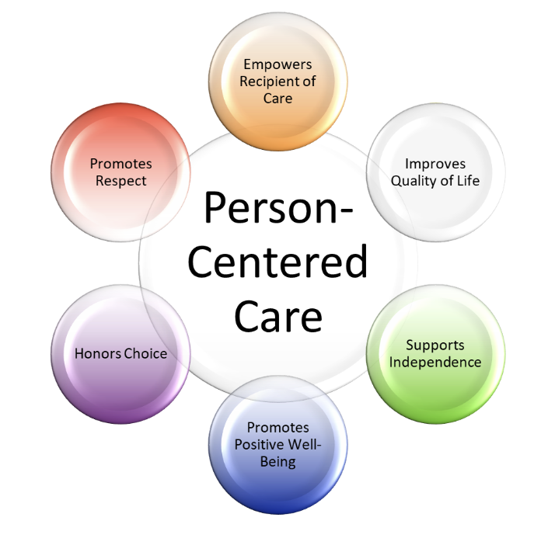
Patient Preference – “I just feel better on it.”
ALWAYS be mindful of and curious about individuals’ experiences.
Notes:
Shared decision making – “I just feel better on it.”

Slide 39
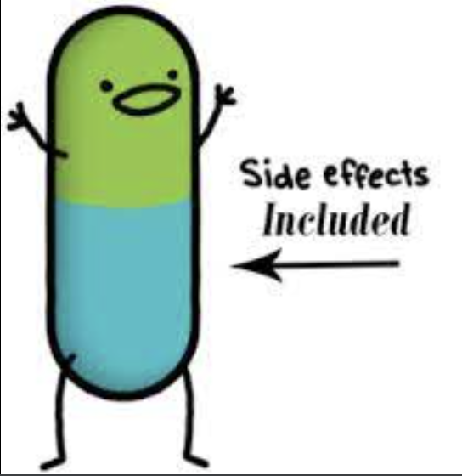
Managing Side Effects
Step 1 – START LOW, GO SLOW
Step 2 – Adjust dose or dosing schedule
Step 3 – Can consider changing agents
Step 4 – Treat side effects with additional medications
https://www.madinamerica.com/2018/09/drug-side-effects-driving-depression-rates/

Slide 40
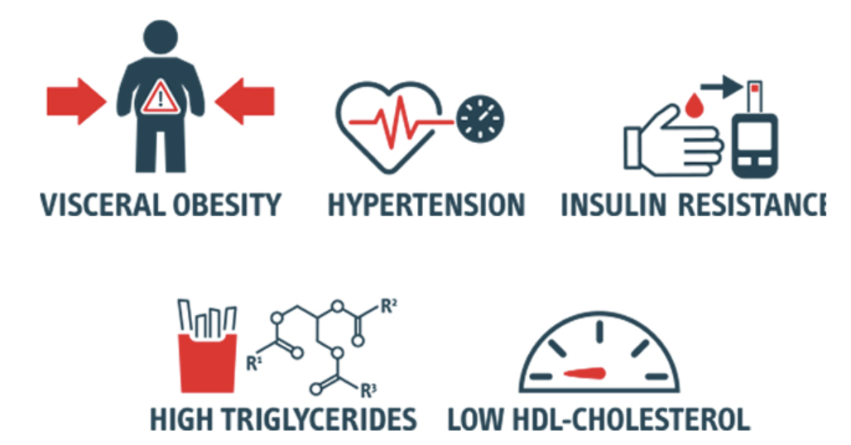
Treat and Prevent Side Effects
Medications for movement disorders if they occur
  Dystonia and Tardive Dyskinesia
  Anticholinergic medications and VMAT inhibitors
Strategies to prevent constipation
Mitigation of weight gain (Prophylax?)
  Dietary, lifestyle and medications (metformin)
  Lybalvi® (olanzapine + samidorphan)
Treatment of akathisia or restlessness
  Propranolol

Slide 41
Address Other Psychiatric Issues
Depression or low mood
Anxiety
Trouble sleeping
Too tired
Negative symptoms and cognitive symptoms?
  More challenging, much excitement right now

Slide 42






Lifestyle Interventions
Can see improvements in mood, cognitive performance, quality of life and/or overall health from:
PHYSICAL EXERCISE
NUTRITION
AVOIDING SUBSTANCES
(ESPECIALLY CANNABIS)
ART & MUSIC

Slide 43

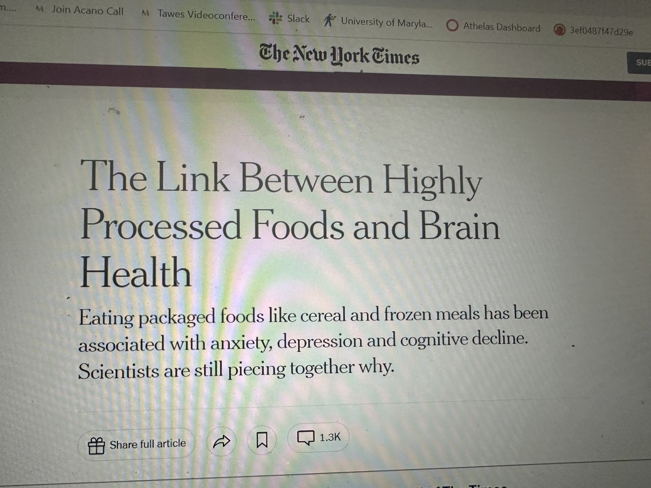

Diet and Mental Health
Dietary style and exercise has been shown to have an impact on mental health through processes such as inflammation, oxidative stress, and brain plasticity.
Several studies have shown that dietary patterns precede the onset of psychiatric symptoms and people on the Western diet, a diet that contains highly processed foods and lacks essential nutrients, are more at risk of developing psychiatric symptoms.
Litta, A. and Ferrandina, M. Diet and Nutrition: Which Role for Mental Health? Psychiatria Danubina. 2023. 35(2), p: 359-363

Slide 44
Improvement in Negative Symptoms
Effect Size: Cohen’s D= -0.53 Total SANS t=2.30, df=1,13.3, p=0.15
ES= -0.24 anhedonia; -0.43 avolition; -0.71 blunting; alogia < -0.12
≥30% decrease in SANS total: 57% (4/7) vs 11% (1/9); Chi-Square=3.88, df=1, p=0.048
Kelly D, Eaton WW, et al. Journal of Psychiatry and Neuroscience, 2019

Slide 45


The Medical Ketogenic Diet & Mental Health
Ketogenic diet: low carbohydrate, moderate protein, high fat diet that induces ketosis
  Dietitian guided, 1.5-2.5;1 ratio
Metabolic state = burn fat and turn it into ketones.
Ketones provide energy for the brain. After a few days or weeks, the body and brain become very efficient at using ketones and fat for fuel instead of carbs
Retrospective studies, open label studies and case reports show improvement in psychiatric symptoms in people with schizophrenia
About a 30% decrease in symptoms
Changes noticed within 2 weeks
Leonard BE, Schwarz M, Myint AM. The metabolic syndrome in schizophrenia: is inflammation a contributing cause? J Psychopharmacol. 2012;26(5_suppl):33–41. 7. Kucukgoncu S, Kosir U, Zhou E, Sullivan E, Srihari VH, Tek C. Glucose metabolism dysregulation at the onset of mental illness is not limited to first episode psychosis: a systematic review and meta-analysis. Early Int Psychiatry. 2019;13(5):1021–31. DeBartolomeis A, De Simone G, De Prisco M, Barone A, Napoli R, Beguinot F, et al. Insulin effects on core neurotransmitter pathways involved in schizophrenia neurobiology: a metaanalysis of preclinical studies. Implications for the treatment. Mol Psychiatry [Internet]. 2023; Available; Sethi, S., et al. Ketogenic Diet Intervention on Metabolic and Psychiatric Health in Bipolar and Schizophrenia: A Pilot Trial. Psychiatry Research, 2024. (335) from: https://www. nature.com/articles/s41380-023-02065 Palmer, C.M., J. Gilbert-Jaramillo, and E.C. Westman, The ketogenic diet and remission of psychotic symptoms in schizophrenia: Two case studies. Schizophr Res, 2019. 208: p. 439-440. (30 Danan, A., et al., The Ketogenic Diet for Refractory Mental Illness: A Retrospective Analysis of 31 Inpatients. Front Psychiatry, 2022. 13: p. 951376.

Slide 46

What is on the Horizon?
New Mechanisms:
Gut microbiome, modulating abundance and function of microbes
  Prebiotic targeting bacteria
Other neurotransmitters
Digital therapeutics- prescription smart phone apps
  Negative symptoms, CBT
Changes to clozapine monitoring, REMS meeting November
  Make your voice heard
  Submit statement in advance

Slide 47
Take Aways
Medications are often necessary, but far from sufficient, component of treatment
Our current meds are good at treating “positive” symptoms of schizophrenia – but not always so good at treating other components
Goals of treatment should be guided by the person receiving it
Lots of options
  Be proactive; ask, advocate and align
  Let provider know what side effects matter, work on goal setting
Reasons to be very hopeful for advances in care!!

