Slide 1
FAMILY PSYCHOEDUCATION
Best Practices
William R. McFarlane, M.D.

Slide 2
How schizophrenia affects families
How families affect schizophrenia
How families help to treat and rehabilitate schizophrenia
How families can help to prevent the onset of schizophrenia

Slide 3
How schizophrenia affects families

Slide 4
Biosocial Theory
Major psychiatric disorders are determined by the continual interaction of specific biological dysfunctions and specific social phenomena
Psychological factors determine course at the case level by influencing biological and social forces

Slide 5
“…the basic defect in schizophrenia consists of a low threshold for (mental) disorganization under increasing stimulus input.” Epstein and Coleman, 1970

Slide 6
Altered Brain Function in Psychosis
Prefrontal cortex activity lessens due to metabolic and structural changes
The limbic system, which assists with attention and the integration of thoughts and feelings, becomes overactive
Hypoactivity of the cingulate cortex creates emotional lability and disconnection of thoughts/feelings
Superior temporal cortex processes language, supports comprehension

Slide 7
Functions of the Prefrontal Cortex
Establishing a cognitive set
Problem-solving
Planning
Attention
Initiative
Motivation
Integration of thought and affect
Mental liveliness

Slide 8
Effects of cognition on behavior
Encoding both internal and external cues
Realistic appraisal of the cues
Decision-making regarding both immediate and long-term goals
Remembering acceptable responses
Evaluating these or new responses
Carrying them out appropriately

Slide 9
People with psychosis often experience:
Social withdrawal
Loss of insight and awareness of illness
Odd, unusual behaviors
Decreased energy and motivation
An inability to enjoy activities
Mood swings
Pervasive anxiety
Disrupted sleep patterns and appetite

Slide 10
Psychosis results from a biologically-based sensitivity to:
Sensory stimulation
Prolonged stress, strenuous demands
Rapid change
Social and occupational complexity
Social disruption
Illicit drugs and alcohol
Negative emotional experience (EE)

Slide 11
There is an optimum relationship between arousal and attention...
In order to pay attention, we need to be aroused on a sensory level.
In a psychotic state, people are over-aroused, which makes it hard to pay attention…information is missed.
With negative symptoms, a person is slow to register information and/or has poor attention.

Slide 12
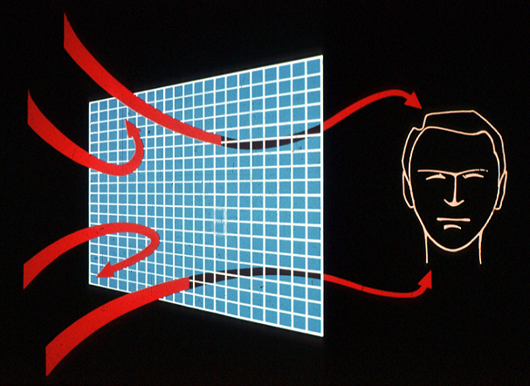

Slide 13
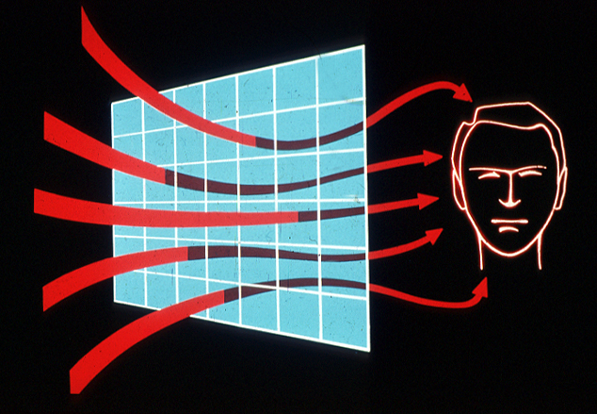

Slide 14
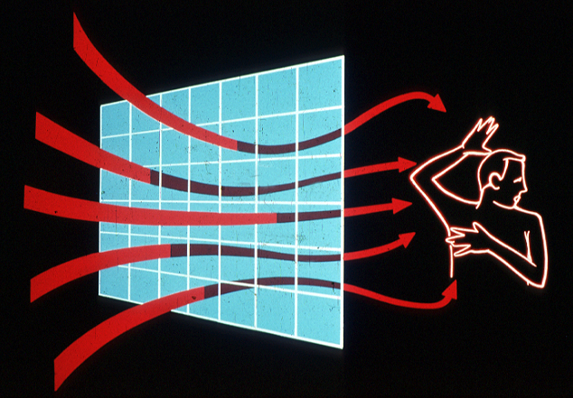

Slide 15
Functioning as an Effect of Number of Psychotic Episodes
Notes:
Graphic representation from our data at EDIPPP/ PRIME – baseline GAF ratings

Slide 16
Guilt
Divorce
“Tough Love”
Anger
Withdrawal
False cures
Shame
Confusion
Helplessness
Depression
Demoralization
Self-blame
Rationalization
Resentment
Rejection
Blaming others

Slide 17
How families affect schizophrenia

Slide 18
Expressed Emotion
Critical comments
Hostility
Over-involvement
Loss of warmth

Slide 19
Expressed emotion and relapse
12%
On med.
13%
Low EE
15%
No med.
15%
On med.
Total
N=
128
28%
< 35 hrs.
42%
No med.
51%
High EE
53%
Low EE = 71
High EE = 57
On med.
69%
> 35 hrs.
92%
No med.

Slide 20
Proportion of families with high EE in years following onset
50%
35%
14%
Hooley, et al, 1995

Slide 21
Components of expressed emotion: Prodromal vs. chronic phase
All differences, prodromal vs. chronic: p<0.01

Slide 22
Effects of Genetic Risk and Family Functioning on Eventual Schizophrenia-Spectrum Disorders
* p < 0.001
**p = 0.582
G X E interaction: p = 0.018
Tienari, Wynne, et al, BJM, 2004

Slide 23
Mutual Causal Effects: Patient Symptoms and Family Interaction
Family interaction
Patient symptoms

Slide 24
Social Networks in Schizophrenia
Family network size
diminishes with length of illness
decreases in the period immediately following the first episode
is smaller at the time of first admission
Networks
buffer stress and adverse events
determine treatment compliance
predict relapse rate
correlate with coping skills and burden

Slide 25
Interaction of Biological and Social Factors
Social isolation
Symptoms

Slide 26
How families help to treat and rehabilitate schizophrenia

Slide 27
Core Elements of Family Psychoeducation
Joining/Engagement
Education
Problem-solving
Interactional change
Structural change
Multi-family relationships

Slide 28
What would you want if you or a loved one developed a psychotic illness?
Ongoing support
Understanding of the illness; what is it?
A Cure
What would help and what would not help
People could trust me; I could have freedom; someone takes me seriously
Supportive housing
Quick access to the support; timeliness
Hope
Know that my family member is taken care of
Respect and choice as a person (person with illness)
Help to calm things down in the home
How to set limits for both person with illness and family member
Experts from different disciplines giving help
Help with the grieving process
As a family member and patient—being part of the team
Stability-knowing that the professional team is going to be there
Financial support: how to access
Be a contributing member of society; be productive
Accommodations—school, employment
Confidentiality issues

Slide 29
What would you want if you or a loved one developed a psychotic illness?
Gain an understanding and have support and reassurance
Feelings fear- education what to expect
Talk to others who had experienced a similar situation
Gain a sense of control and hear others experience
Education that is in layman's terms as well as a specialist
Would want to know that MI is a disease access best medical practice
Team approach share expertise empathy
What caused the illness and why?
Feeling a need to control the symptoms ASAP, tx safe, works, why
What is the prognosis and what to expect in the future
Would want family and loved ones to have an understanding and help
As a parent how will this affect my children current as well as future children and siblings
Know what the early warning signs are so that possible prevention of problems- what to look for to anticipate symtoms and what to do

Slide 30
Therapeutic Processes in Multifamily Groups
Stigma reversal
Social network construction
Communication improvement
Anxiety and arousal reduction
Crisis prevention
Treatment adherence
Eliciting hope

Slide 31
Family Psychoeducation Tools
Separate symptoms from personality
Identify problems
Prioritize steps
Develop actions
Delegate and distribute tasks
Explore multiple options rather than the same one

Slide 32
Social Networks and Multifamily Groups
COMMUNITY
F
EXTENDED FAMILY
E
EXTENDED
MULTIFAMILY GROUP
FAMILY
PATIENT
A
B
C
D

Slide 33
Stages of a Psychoeducational Multifamily Group
Joining
Educational Workshop
Ongoing MFG
Family and client separately + together;
3 - 6 meetings;
Start psychoeducation
Families and clients;
6 hours with focus on Family Guidelines
Families and clients;
1 - 2 years

Slide 34
Phases and Interventions in Family Psychoeducation Year One: Relapse Prevention
Engaging individual families
Multifamily educational workshop
Implementing family guidelines
Reducing stigma and shame
Lowering expectations
Controlling rate of recovery
Reducing intensity and exasperation

Slide 35
Phases and Interventions in Family Psychoeducation Year Two: Rehabilitation
Gradually increasing responsibilities
Moving one step at a time--the internal yardstick
Monitoring encouragement from family members
Establishing inter-family relationships
Cross-parenting
Focusing family interests outside family
Restoring family's natural social network

Slide 36
Relapse Outcomes in Clinical Trials with Schizophrenia

Slide 37
Employment/School Outcomes Before and After Psychoeducational MFG

Slide 38
Components of first episode psychosis services: Evidence level A and rated as essential by international experts
Domain names and Components with level of supporting evidence (A-D) | Semi-Interquartile Range
Selection of Antipsychotic Medication (Level of evidence: A) | .5
Clozapine for Treatment-Resistance (Level of evidence: A). | .5
Use of Single Antipsychotics (Level of evidence: A) | .5
Psychoeducational Multifamily Group Psychoeducation (MFG) (Level of evidence: A) | .5
Supported Employment (Level of evidence: A) | .37
Addington, et al., Psych. Servs., 2013

Slide 39
Current reviews and analyses
FPE as a clinical intervention for schizophrenia is now considered a solid evidence-based effective practice for reducing relapse and hospitalizations, and for several functional outcomes, especially in conjunction with effective psychiatric medication.
“…studies on psychoeducation in schizophrenia in real-world settings show results comparable to those in experimental settings.”
Rummel-Kluge & Kissling (2008)

Slide 40
Family-aided Assertive Community (FACT) Treatment
Transdisciplinary team treatment planning, implementation and case accountability
Proactive outreach to clients and family members/supports
Family psychoeducation as an integral aspect of team’s work
Occupational therapy
Supported employment
Supported Education
In-vivo and home-based treatment, as needed
Crisis prevention and intervention

Slide 41
FACT Clinical Team (Team treatment planning and integration of services)
Program Manager
Team Clinicians
Case Manager
Occupational Therapist
Employment/ Education Specialist
Psychiatrist/ NP
Nurse
Peer Support Specialists

Slide 42
All team members
Conduct outreach presentations and trainings in community
Provide community-based treatment to families (FACT Model)
Provide rapid, crisis-oriented initiation to treatment
Co-facilitate psychoeducational multifamily groups
Focus on wellness

Slide 43
Essential Elements of FACT
FULL RESPONSIBILITY FOR TREATMENT SERVICES: in addition to case management and psychiatric services, program directly provides counseling / psychotherapy, housing support, substance abuse treatment, employment and education support, and rehabilitative services.
RESPONSIBILITY FOR CRISIS SERVICES: program has 24-hour responsibility for covering psychiatric crises.
INVOLVEMENT IN HOSPITALIZATION: program is involved in hospital admissions and discharges back to the program.
WORK WITH SUPPORT SYSTEM: with or without client present, program provides support and skills for client's support network: family, landlords, employers.

Slide 44
Essential Elements of FACT
IN-VIVO SERVICES: program works to monitor status, develop community living skills in vivo, rather than in office, when clinically indicated or required by the nature of the skills involved.
NO DROPOUT POLICY: program engages and retains clients at mutually satisfactory level.
ASSERTIVE ENGAGEMENT MECHANISMS: as part of assuring engagement, program uses community outreach, as well as legal mechanisms (e.g., representative payees, probation/parole, OP commitment) as indicated.
INTENSITY OF SERVICE: high total amount of service time as needed.
FREQUENCY OF CONTACT: high number of service contacts as needed.

Slide 45
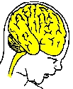
Early Insults
Social and Environmental Triggers
e.g. Disease Genes, Prenatal Infections and Trauma, Environmental Toxins
Increasing Positive symptoms
Biological Vulnerability: CASIS
Disability
Cognitive Deficits
Affective Sx: Depression
Social Isolation
School Failure
Brain Abnormalities
Structural Biochemical Functional
Cornblatt, et al., 2005

Slide 46
How families can help to prevent the onset of schizophrenia

Slide 47
Early Detection in Another Illness
“If you catch cancer at Stage 1 or 2, almost everybody lives. If you catch it at Stage 3 or 4, almost everybody dies. We know from cervical cancer that by screening you can reduce cancer up to 70 percent. We’re just not spending enough of our resources working to find markers for early detection.”
– Lee Hartwell, MD Nobel Laureate, Medicine President and Director, Hutchinson Center New York Times Magazine December 4, 2005, p. 56

Slide 48
Biosocial causal interactions in late schizophrenic prodrome
Early prodrome
Late prodrome
Acute onset
Social & functional deficits
Withdrawal
"Oddness" Functional deterioration
Social deficits
Critical comments CD
Anxiety
Panic Misattribution
High EE
Psychosis
Perceptual distortions
Pervasive anxiety
Illusions
Dread Insomnia Anorexia

Slide 49
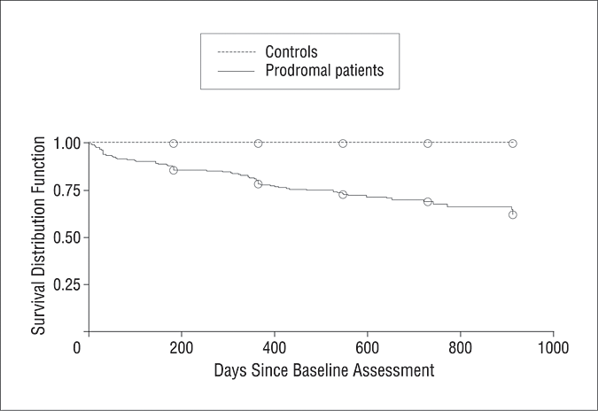
Cumulative survival distribution function modeling time to conversion to psychosis in 291 prodromal patients and 134 demographically comparable normal control subjects
Cannon, T. D. et al. Arch Gen Psychiatry 2008;65:28-37.

Slide 50
Trials of Indicated Prevention
Buckingham, UK
EDIE, UK
GRN, Germany
OPUS, Denmark
PACE, Australia
PRIME, North America
Omega-3 FAs, Austria
PIER, Maine
EDIPPP, USA

Slide 51
Psychosis prevention studies: One year rates for conversion to psychosis
N=325

Slide 52
Global results for randomized clinical trials n = 325
Control conversion rate, mean: 32.0%
Experimental conversion rate, mean: 9.6%
Effect size: 3.7
Number need to treat (NNT): 4-5

Slide 53
Portland Identification and Early Referral (PIER)
Reducing the incidence of major psychotic disorders in a defined population, by early detection and treatment:
Indicated prevention

Slide 54
PIER Program Overview
PIER
Education
Material
Development
Professionals
General
Public
Clinical Work
Assessment
Psychosocial
Treatment
Pharmacological
Treatment
Research

Slide 55
Professional and Public Education
Reducing stigma
Information about modern concepts of psychotic disorders
Increasing understanding of early stages of mental illness and prodromal symptoms
How to get consultation, specialized assessments and treatment quickly
Ongoing inter-professional collaboration

Slide 56
Family practitioners
College health services
Mental health clinicians
Pediatricians
Military bases and recruiters
School teachers, guidance counselors, nurses, social workers
PIER Team
Clergy
Employers
Advertising
Emergency and crisis services
GeneralPublic

Slide 57
Family practitioners
College health services
Mental health clinicians
Pediatricians
Military bases and recruiters
School guidance counselors, nurses, social workers
PIER Team
Clergy
Employers
Emergency and crisis services
General Public

Slide 58
Assessing Risk for Psychosis

Slide 59
Structured Interview for Psychosis-Risk Syndromes (SIPS)
Developed at Yale University
Assesses symptoms of high risk for psychosis (but with preservation of insight)
Measures severity and change
Inter-rater reliability and predictive validity
Translated into 14 languages
PQ-B (Prodromal Questionnaire-Brief) is a pre-screening tool for the SIPS
Notes:
59
59

Slide 60
Family-Aided Assertive Community (FACT) Treatment
Transdisciplinary team treatment planning, implementation and case accountability
Proactive outreach to clients and family members/supports
Family psychoeducation as an integral aspect of team’s work
In-vivo and home-based treatment, as needed
Crisis prevention and intervention

Slide 61
Key Clinical Strategies in Family Intervention Specific to Prodromal Psychosis
Strengthening relationships and creating an optimal, protective home environment:
Reducing intensity, anxiety and over-involvement
Preventing onset of negativity and criticism
Adjusting expectations and performance demands

Slide 62
Key Clinical Strategies in Family Intervention Specific to Prodromal Psychosis
Minimizing internal family stressors
Marital stress
Sibling hostility
Confusion and disagreement
Buffering external stressors
Academic and employment stress
Social rejection at school or work
Entertainment stress
Romantic and sexual relationships

Slide 63
Cognitive Behavioral Therapy
The aim of CBT is to help the individual reduce distress and gain a better understanding of triggers and factors associated with their symptoms.
What you do (behavior) and what you think (cognition) affects how you feel.
Individuals learn to be curious about their thoughts and experiences in order to develop more control over how they respond to them.

Slide 64
Early Detection and Intervention for the Prevention of Psychosis
Effectiveness Trial at six sites:
Portland, Maine / Maine Medical Center
Glen Oaks, New York / Albert Einstein College of Medicine
Ann Arbor, Michigan / University of Michigan
Salem, Oregon / Oregon Health Sciences University
Sacramento, California / University of California at Davis
Albuquerque, New Mexico / University of New Mexico
Sponsored by RWJF
Regression discontinuity and incidence reduction
Large and representative sample
Community outreach and identification systems
Basis for dissemination

Slide 65
Demographic and Psychosocial Characteristics
 | Total (N = 337) | Clinical Low Risk (n = 87) | Treatment High-Risk (n = 250)
 |  |  | Clinical High-Risk (n = 205) | Early 1st Episode (n = 45)
Age (mean) | 16.6 | 16.2 | 16.4 | 17.9
Female, n (%) | 134 (40%) | 26 (30%) | 89 (43%) | 19 (42%)
Caucasian, % | 62% | 71% | 61% | 47%
African-American, (%) | 9% | 6% | 8% | 22%
Asian-American, n (%) | 13 (4%) | 4 (5%) | 9 (4%) | 0 (0%)
Hispanic | 15% | 8 (9%) | 33 (17%) | 6 (16%)
In School/Working, % | 83% | 84% | 84% | 80%
Income (dollars) | 40K – 50K | 50K – 60K | 40K – 50K | 30K – 40K
Notes:
65

Slide 66
Clinical Characteristics
Current SCID-IV Axis-I Diagnoses | Total (n = 337) | Clinical Low-Risk (CLR) (n = 87) | Treatment (High-Risk) (n = 250) |  | p
 |  |  | Clinical High Risk (CHR) (n = 205) | Early First Episode (EFEP) (n = 45)
No Diagnosis | 14% | 22% | 14% | 0% | <.01
Mood Disorder | 42% | 37% | 49% | 18% | <.01
(1) Bipolar | 16 (5%) | 2 (2%) | 12 (6%) | 3 (7%) | .38
(2) Major Depression | 114 (34%) | 27 (31%) | 83 (41%) | 3 (7%) | <.01
Substance Abuse | 28 (8%) | 8 (9%) | 7% | 5 (11%) | .66
Notes:
66

Slide 67
Rates of Conversion or Relapse Over 24 months
 | Low-risk | High-risk | Early FEP
n | 87 | 205 | 45
Severe Psychosis | 2.3% | 6.3%
Relapse |  |  | 11%
Negative Events* | 22% | 25% | 40%
*Hospitalizations, incarcerations, suicide attempts, assaults, rape
Notes:
67

Slide 68
In school or working: Baseline and 24 months

Slide 69
EDIPPP: First Episode Psychosis hospital admissions Intervention areas / control areas: CA, ME, MI, NY, OR

Slide 70
Outcomes in 7 PIER Programs*
CHR cases, age 12-25 | Baseline N=552 | Conf. intv. (.05) | 12 Months N=214 | Conf. intv. (.05)
Working | 11% | +/- 6 | 23% | +/- 23
In school | 64% | +/- 15 | 70% | +/- 8
Volunteering | 2% | +/- 4 | 7% | +/- 16
Average GAF score | 43 | +/- 3 | 56 | +/- 12
Onset of Psychosis | NA | NA | 2% | +/- 5
Hospitalizations | 8% | +/- 8 | 12% | +/- 22
Incarcerations | 2% | +/- 4 | 1% | +/-5
Suicide attempts | 3% | +/- 6 | 6% | +/- 19
Suicides | NA | NA | 0% | +/- 0
*San Diego, Santa Clara, Ventura, Contra Costa, CA Counties, Weber County, UT and State of Delaware

Slide 71
PIER long-term outcome 4-12 years after identification of risk
During 2-year treatment, 2001-2009
Received any treatment | 139 | 100%
Severe episode | 14 | 10%
Post-2-year treatment, 2-10 years
Followed-up | 72 | 52%
Severe psychosis or hospitalization | 9 | 13%
In school or working | 55 | 76%

Slide 72
Conclusions
Public education influences attitudes, knowledge and behavior.
Accurate referrals come from outside the mental health system.
Treatment blocks the final common pathway to psychosis.
Medication at low doses is reserved for prevention of imminent psychosis.
Psychoeducational MFG is the most potent treatment component.
Very low conversion or relapse rates (<10%) and functional improvement accompany comprehensive treatment.
A substantial proportion of the incident population can be identified and prevented from developing psychosis and severe disability.

